Slide 1

LAPLACE TRANSFORM IN RADIOACTIVE DECAY
By
SAI DINESH – 20PW30
SAMBANTHAM – 20PW31
SANJITH - 20PW32

Slide 2
RADIOACTIVE DECAY
The spontaneous decomposition of a nucleus forming a different nucleus and producing one or more additional particles.

Slide 3
RADIO ACTIVE DECAY
Radioactive decay occurs when an unstable atomic nucleus loses energy by emitting energy in the form of emitted particles or electromagnetic waves, called radiation.
Radioactivity can be categorized chiefly according to their nuclear energetics into; alpha-decay, beta-decay, gamma-ray emission, internal conversion, electron capture and positron decay

Slide 4
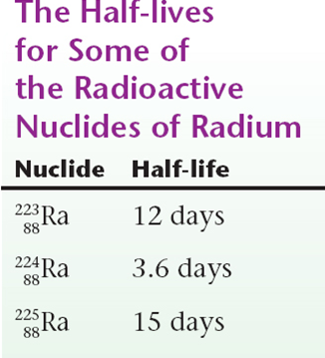
HALF LIFE
Half-life is the length of time it takes for half of the radioactive atoms of a specific radionuclide to decay.
For example, technetium-99m, one of the most common medical isotopes used for imaging studies, has a half-life of 6 hours.

Slide 5
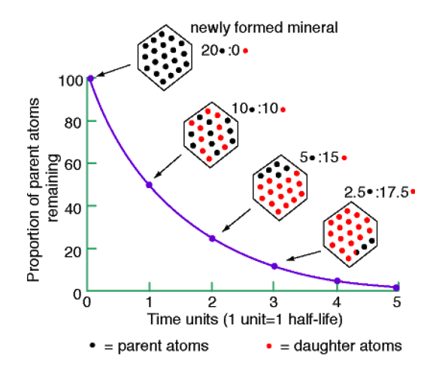
Decay of a Radioactive Element
Half of the radioactive parent atoms decay after one half-life. Half of the remainder decay after another half-life and so on……..

Slide 6
LAW OF RADIO ACTIVE DECAY
The rate of decay of a substance is directly proportional to the amount of substance present at that time.
dN/dt ∝ N

Slide 7

Consider the following first order linear differential equation:
We can use the Laplace Transform to solve this equation.

Slide 8

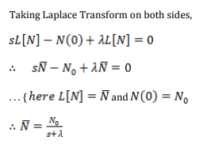
Rearranging the above equation, we get

Slide 9
Now, Taking Inverse Laplace Transform on both sides, we get
Which is indeed the correct form for radioactive decay

Slide 10
EXAMPLE
phosphorus substance is known to decay at a rate proportional to the amount present. If initially there is 1000 milligrams of the phosphorus substance present after five hours it is observed that the phosphorus substance has lost 20 percent of its original mass, find the life of the phosphorus substance.

Slide 11
The problem can be written in mathematical form as
𝑑𝑃(𝑡)/ 𝑑𝑡 = −𝛼𝑃(𝑡)
Where P denote the amount of phosphorus substance at time t and 𝛼 is the constant of proportionality.
Consider 𝑃₀ is the initial amount of the phosphorus substance at time 𝑡 = 0.
By applying Laplace transform
𝐿 [ 𝑑𝑃/ 𝑑𝑡 ] = −𝛼𝐿[𝑃(𝑡)]

Slide 12
Now applying the property, Laplace transform of derivative of function, and at 𝑡 = 0, 𝑃 = 𝑃₀ = 1000, we have
𝑠𝐿[𝑃(𝑡)] −1000 = −𝛼𝐿[𝑃(𝑡)]
==> 𝐿[𝑃(𝑡)] = 1000/(𝑠+𝛼)
𝑃(𝑡) = 𝐿−¹ [ 1000/(𝑠+𝛼) ]
𝑃(𝑡) = 1000𝑒^(-𝛼t)

Slide 13
Now at, t=5, the phosphorus substance has lost 20 percent of its original mass 1000 mg so 𝑃(5) = 1000 − 200 = 800, we have
800 = 1000𝑒^( −5𝛼)
𝛼 = -log(0.8)/5
𝛼 = 0.04462871026
Here we want to find time
𝑃 = 𝑃₀/2 = 500

Slide 14
500 = 1000𝑒 ^(-(0.04462871026)*t)
=> 𝑡 = log(0.5)/(−0.04462871026 )
=> 𝑡 = 15.5314186
15.53 hours required half time of the phosphorus substance.

Slide 15

CODE IMPLEMENTATION

Slide 16

THANK YOU

